Slide 1

JAYPEE UNIVERSITY OF INFORMATION TECHNOLOGY, WAKHNAGHAT
Brain Tumor Detection & Classification
Submitted By:
Abhiti Labroo CS-61 191225
Aman Gupta CS-61 191228
Mentored By:
Mr. Aman Sharma

Slide 2
CONTENTS
Introduction
Regarding the Dataset
Related Work
Methodology
Project Development
Pre Trained model VGG-16
CNN Model
Representation of Results
Conclusion and Future scope
References

Slide 3
INTRODUCTION
Brain tumor is one of the most thorough and painstaking sicknesses in clinical science. They are broadly divided into two categories benign and malignant.A benign tumor is not equivalent to a cancerous tumor. Thus, it doesn't spread to different regions of the brain.The malignant tumor is a cancerous tumor in its nature which basically results in its rapid and endless spreading.
In this comparison model, with the assistance of a Convolutional Neural Network (CNN) and VGG-16 model under machine learning the tumor is classified into its types like gliomas, meningioma, and pituitary tumors. The accurate and precise distinction among the three types of brain tumors signify a very crucial phase of the medical diagnostic procedure and later successful evaluation of patients.

Slide 4
DATASET USED
The dataset used for the project is a Kaggle dataset[1]. The dataset has Magnetic Resonance Images of the brain. The project is intended to have a multi-class classification due to which the dataset has 4 classes.
The dataset is divided into Training and Testing sets. In the Training set there are 2870 files(826 files for glioma tumor, 822 files for meningioma tumor and 827 files pituitary tumor and 395 files for no tumor) and for
Testing set there are files(100 files for glioma tumor, 115 files for meningioma tumor and 74 files pituitary tumor and 105 files for no tumor)
The Training to Testing set ratio is 88% : 12%

Slide 5
BRIEF LITERATURE REVIEW
AUTHORS | DATASET USED | YEAR PUBLISHED | METHODOLOGY | PERFORMANCE METRICS
Khodadadi et al. [2] | T-1 Weighted Contrast MRI Images | 2020 | Fuzzy C-Mean Algorithm was used for Image Processing and different models like KNN,SVM and PatternNet for classification. | Sensitivity, Specificity and Accuracy
Fernandes et. al.[3] | Local, HARVARD and RIDER datasets | 2017 | Brain Surface Extractor Algorithm was used for Image Processing and SVM on different datasets and differents fold of cross validation was done. | Sensitivity, Specificity, AUC and Accuracy
Das et al.[4] | T-1 Weighted Contrast MRI Images | 2019 | Resizing and Gaussian Filter was done for Image Processing. ANN and CNN model were compared infer that parameters are reduced in CNN and then Adam Optimizer was used. | Recall, F1-Score, Precision and AUC
Rehman et al. [5] | BRATS’15, BRATS’17, BRATS’18 | 2020 | CNN architecture for B.T extraction,VGG-19 for deep feature extraction and Pearson with ANN for final classification | Accuracy

Slide 6
Irmak [6] | RIDER,REMBRANDT,TCGA-LGG and T-1 Weighted Contrast MRI Images dataset | 2021 | Three CNN models were used for the three classification tasks in the model.Grid Search Optimizer was used to optimise the hyper parameters of CNN model. 5-fold cross validation was used | Sensitivity, Specificity, AUC and Accuracy
Wu Jue et al.[7] | Small dataset of 253 images. | 2020 | Canny edge Detection Technique was used for Image Processing and data augmentation was performed as dataset is small. Build CNN model was compared with pre trained models of Transfer learning approach. | Accuracy of Validation and Training dataset for different pre trained and developed CNN model
Badža and Barjaktarovi´c[8] | T-1 Weighted Contrast MRI Images dataset | 2020 | B.T classification model was built using CNN architecture and k-fold cross validation was done to test n/w Adam Optimizer was used to optimise hyper parameters. | Recall, F1-Score, Precision and Accuracy

Slide 7
METHODOLOGY
For the comparison model, two of the deep learning models that are Convolutional Neural Network(CNN) and pre trained Keras model VGG-16 was used for the dataset.
Primarily the VGG-16 was implemented on the dataset for the reasons that the architecture performs well in image detection and its classification and it was also winner for ImageNet detection challenge in 2014.
The CNN in particular was chosen for the following reasons-
Models with CNN architecture are known for working well with object detection,image classification and especially for image classification.

Slide 8
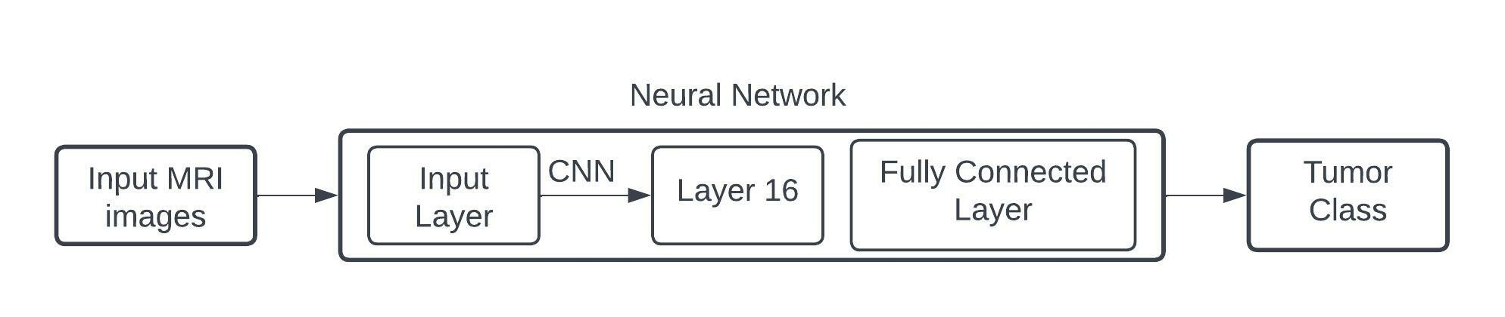
2. It has been observed that overall performance of the model with CNN Architecture tend to be good.
3. One of the major reasons , CNN model was selected is that across all different types of tumors, the CNN model can maintain relatively high in all the precisions, recalls.
Figure 1: Design of Project problem

Slide 9
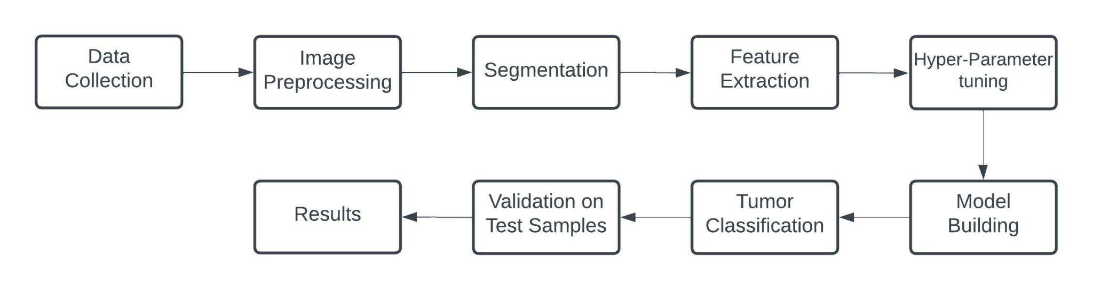
PROJECT DEVELOPMENT
Figure 2: Flow of Data In Project

Slide 10
DATA COLLECTION- Data collection is the process of gathering and measuring information from different sources.
IMAGE PRE-PROCESSING- Image preprocessing are the steps taken to format images before they are used by model training and inference. This includes resizing, orienting,removing noise and color corrections.
SEGMENTATION- Image segmentation results in more granular information about the shape of an image and thus an extension of the concept of Object Detection. Divide the images into regions of different colors which helps in distinguishing an object from the other at a finer level.
FEATURE EXTRACTION - Feature extraction refers to the process of transforming raw data into numerical features that can be processed while preserving the information in the original data set. It yields better results than applying machine learning directly to the raw data.
HYPER PARAMETER TUNING -In machine learning, hyperparameter tuning aims to choose a set of optimal hyperparameters for a learning algorithm. It is mainly used for controlling the behaviour of the machine.

Slide 11
MODEL CONSTRUCTION - The three stages to build the hypotheses in machine learning are model building, model testing and applying model which results in Model Construction.
TUMOR CLASSIFICATION- The tumors in our project are classified into 4 classes that are- Gliomas, Pituitary,Meningiomas and no tumor.
VALIDATION ON TEST SAMPLES- In machine learning, model validation is referred to as the process where a trained model is evaluated with a testing data set. The testing data set is a separate portion of the same data set from which the training set is derived.
RESULTS - After the completion of the project this segment contains detailed analysis of the comparison model and all the conclusions drawn.

Slide 12
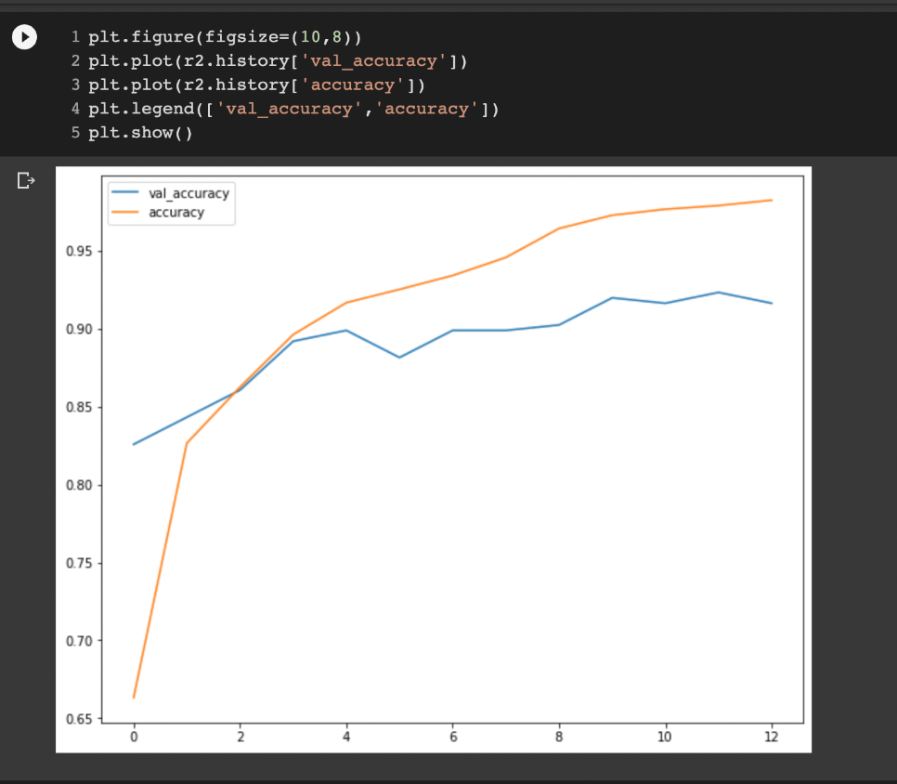
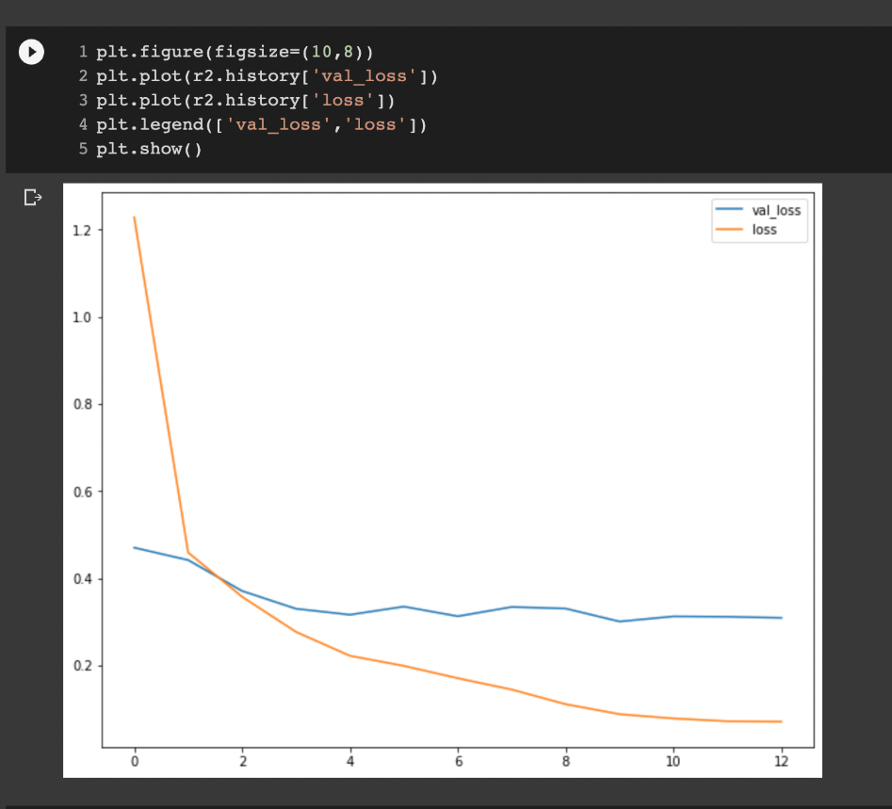
PRE TRAINED MODEL -VGG16
Figure 3-4: Accuracy and Loss for Testing and Training in case of VGG-16

Slide 13
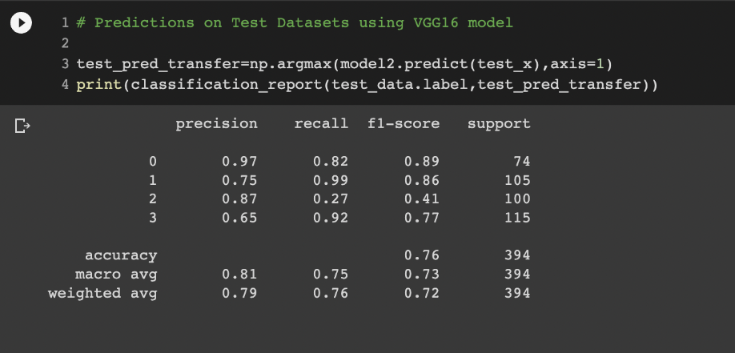
Figure 5: Performance parameters of Pre trained VGG-16 model

Slide 14
This result is in accordance with pre trained model of Keras VGG-16. This pre trained model was implemented on the same dataset that the CNN model is implemented on.The accuracy of the pre-trained VGG-16 model is approximately 76%, which is quite average. This is the reason why the need for CNN architecture was felt and the comparison model was built.

Slide 15
CNN ARCHITECTURE FOR THE COMPARISON MODEL
Figure 5: Accuracy of Pre trained VGG-16 model

Slide 16
PSEUDO CODE AND ALGORITHM
Pseudo code 1 Pre Processing:
1. Func create_training_data(): #Function for creating training data array
2. class_num <- category_index #Getting category labels for Images
3. For image in images
4. img_array <- read_image
5. new_array <- resize_image(img_array) #resizing images
6. training_data <- append(new_array,class_num)
Pseudo code 2 Model Building :
1. model <- init_sequential()
2. Add input layer
3. Add convolution layer, set filters(64 or 128 or 256), kernel size(3x3 or 5x5),etc
4. Add max pooling layer, set pool size(2x2), etc
5. Add dropout layer, set the dropout percent
6. Repeat steps 3-5 as required
7. Flatten the output of these layers
8. Add dense and dropout layers
9. Get classification as output

Slide 17
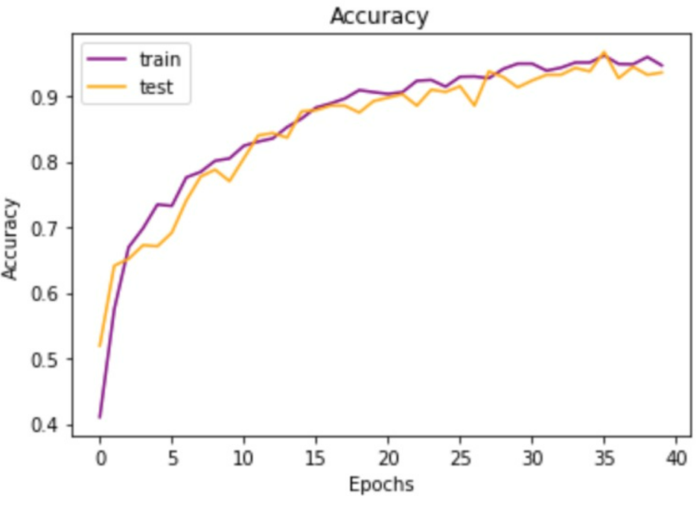
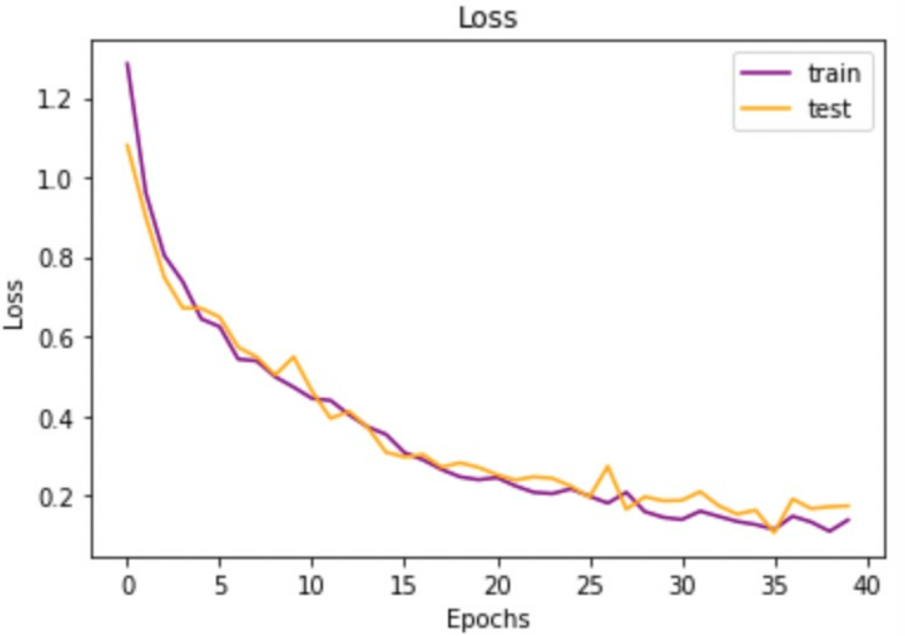
CNN MODEL
Figure 5: Accuracy and Loss for Testing and Training in case of CNN

Slide 18
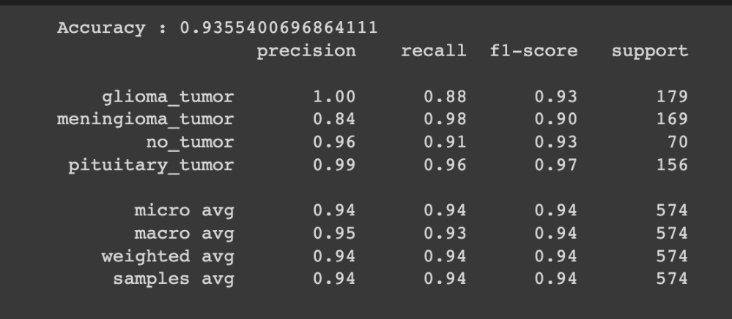
Figure 5: Accuracy of CNN model

Slide 19
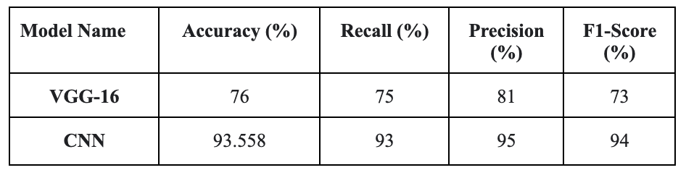
TABULAR REPRESENTATION OF RESULTS
Table 2: Performance Comparison of Deep learning models
Performance parameters used for both VGG-16 and CNN model were accuracy, recall, precision, and F1 score.

Slide 20
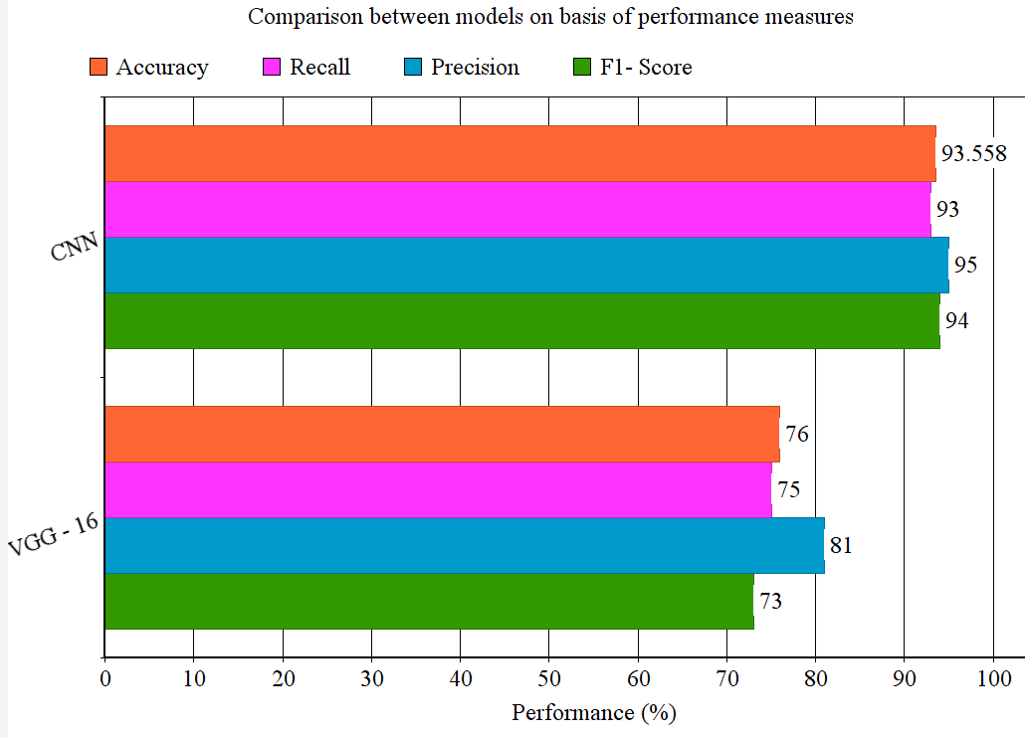
GRAPHICAL REPRESENTATION OF RESULTS

Slide 21
CONCLUSION AND FUTURE SCOPE
In light of the preceding section, two comparison models CNN and VGG-16 were developed, for the same dataset. The results achieved were basically evaluated and visualized with help of the performance measures.
The processing of each step has an impact on performance metrics, primarily accuracy computed at the end. Finally, this model completes the task of brain tumor classification. As clearly seen CNN outperformed VGG-16
Potential future scope of this project is opting for more optimized and higher accuracy deep learning algorithms for brain tumor classification.

Slide 22
REFERENCES
[1] Bhuvan, S. (2020). [Brain Tumor Classification (MRI)] [Data Set]. Kaggle.
[2] Salem Ghahfarrokhi, S., & Khodadadi, H. (2020). Human brain tumor diagnosis using the combination of the complexity measures and texture features through magnetic resonance image. Biomedical Signal Processing and Control, 61, 102025. doi:10.1016/j.bspc.2020.102025.
[3] Amin, J., Sharif, M., Yasmin, M., & Fernandes, S. L. (2017). A distinctive approach in brain tumor detection and classification using MRI. Pattern Recognition Letters. doi:10.1016/j.patrec.2017.10.036.
[4] Das, S., Aranya, O. F. M. R. R., & Labiba, N. N. (2019). Brain Tumor Classification Using Convolutional Neural Network. 2019 1st International Conference on Advances in Science, Engineering and Robotics Technology (ICASERT). doi:10.1109/icasert.2019.8934603.

Slide 23
[5] Rehman, A., Khan, M. A., Saba, T., Mehmood, Z., Tariq, U., & Ayesha, N. (2020). Microscopic brain tumor detection and classification using 3D CNN and feature selection architecture. Microscopy Research and Technique. doi:10.1002/jemt.23597.
[6] Irmak, E. (2021). Multi-Classification of Brain Tumor MRI Images Using Deep Convolutional Neural Network with Fully Optimized Framework. Iranian Journal of Science and Technology, Transactions of Electrical Engineering, 45(3), 1015–1036. doi:10.1007/s40998-021-00426-9.
[7] Khan HA, Jue W, Mushtaq M, Mushtaq MU. Brain tumor classification in MRI image using convolutional neural network. Math. Biosci. Eng. 2020 Sep 1;17(5):6203-16.
[8]Badža, M. M., & Barjaktarović, M. Č. (2020). Classification of Brain Tumors from MRI Images Using a Convolutional Neural Network. Applied Sciences, 10(6), 1999. doi:10.3390/app10061999.

